Slide 1
Good Requirements
The Very Short Course

Slide 2
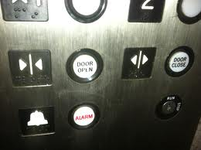
What Could Go Wrong?

Slide 3
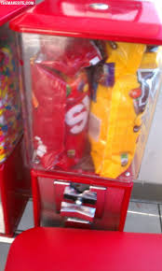
What Could Go Wrong?

Slide 4
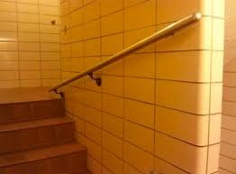
What Could Go Wrong?

Slide 5
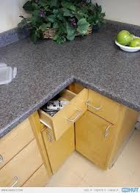
What Could Go Wrong?

Slide 6
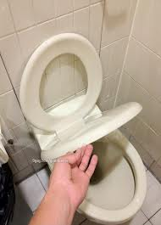
What Could Go Wrong?

Slide 7
Expectations
You are here because you
Are interested in developing better requirements
Want to add some new toys to your toybox
Were “volunteered” or are being polite
Want the free lunch
Andy Will
Do my best to make it interesting and keep you awake
Leave you with some things you can use NOW
You will
Listen attentively
Set cell phones to stun
Nod politely, not nod off

Slide 8
Why are requirements important (What could possibly go wrong) ?
What leads to bad requirements?
What happens
We rush to implement
Often realize it was wrong but have so much invested we don't fix it
We mock and mourn for a long time after
Relative cost to fix
If you doubt this just remember that at most companies average loaded labor rate each of us costs over $1/minute
The Classic Tire Swing

Slide 9
Relative Cost to Fix

Slide 10
Project Reality

Slide 11
The Human Aspect of Poor Requirements
Listen and you will hear …
We have bright people trying to do a good job
A hurry to get done
Poor communications of requirements
No agreement on format
No verification of understanding
No feedback confirmation during “development”
Late realization of problems
Too invested to stop and fix it
Just live with what resulted
Mockery and mourning

Slide 12
Let’s Watch a Movie
http://www.youtube.com/watch?v=-YFRUSTiFUs

Slide 13
What is a requirement? (The Very Short Answer)
A condition or capability needed by a stakeholder to solve a problem or achieve an objective-Blah, Blah, Blah
WHAT. . . someone really needs or wants
WHY . . . they want or need it
WHO . . . will need it
WHEN . . . does it have to happen
HOW . . . ONLY in HOW it will be used or how people work—Never how to do the implementation.

Slide 14
Satisfy Three People
Your Inner Two-Year-Old
Why, why, why, why, why . . . . . . . . . . . . . . .
Red and Green envelope example
Your Inner Anthropologist
What problem are you trying to solve?
How do you work?
Who else is involved?
What are the legacies at play?
Your Significant Other
Let me play back what I think I heard
What does success or happiness look like?
If I deliver x will that satisfy what you want?

Slide 15
Assumptions
Why they are dangerous?
How to avoid them
Why, Why, Why
Role Play
Mockups
Walk-Throughs

Slide 16
Rules, Rules, Rules
Most people tend to think in terms of what they do
Most people have difficulty in articulating exactly what they do--and more importantly—why
Articulating rules can help

Slide 17
Takeaways
Homework
Within 24 hours pick a task at home or work
Who, What, When, Where, Why
Play back your understanding
Satisfy those three important people
GOOD Requirements are about Understanding and Verifying
Setting Proper Expectations

Slide 18
Questions?
Thank you

Slide 19
Thank you
Andy Roth
LinkedIn: www.linkedin.com/in/andyroth1
Blog: andyroth76.wordpress.com
Email: andyroth@bellsouth.net
Twitter: @andyroth76

